Slide 1
EDUC2323 Computer Programming as a Tool for Learning

Slide 2
Plan
Advanced Scratch concepts: broadcasting and simple animation
Activities:
Analysing broadcasting demo project
Creating simple conversation in Scratch with broadcasting
Working on individual practical project

Slide 3
A reminder of what we are looking for…
Project is ‘Equivalent’ to 500 words – what does this mean?
Handbook p11: “The submitted project should feature learning through exploration or experimentation. In very simple terms, someone should learn something by doing something. It may be you doing the learning as the project’s developer, or someone else doing the learning as the project’s end user (perhaps a hypothetical school pupil).
The ‘richer’ you can make the learning in the project, either for you as the developer or for someone as the user, the more potential there is for your project to do well. A project based solely around ‘rote-learning’ (for instance, a set of ‘flash cards’) is unlikely to do well in this assessment.”

Slide 4
What about assessment?
Based on how you have applied the programming concepts, techniques and ideas from the module (and other sources you have found) in a creative and functional way.
Knowledge and understanding in this instance includes how students have made use of a range of relevant programming concepts and techniques covered during the module.
Use of evidence in this instance includes how students make use of existing ideas, methods, approaches and programming projects (citing these as necessary using comments or the ‘notes and credits’ box).
Evaluation and interpretation in this instance includes how students build on and develop the programming techniques covered during the module, potentially also making use of properly referenced third party sources, to meet the project’s intentions.
Presentation in this instance includes how students design the ‘look-and-feel’ of their project to suit their intended user groups and applications. This covers aspects such as the appropriate use of user interaction, Scratch stage backgrounds, costumes, sounds and animation. It also covers how code blocks and scripts have been presented and commented (as necessary).

Slide 5
Identifying your use and adaptation of other people’s ideas and code - avoiding plagiarism…
Handbook p14 covers in detail
Good practice to re-purpose other’s ideas and code – we don’t want to reinvent wheel but…
For the purposes of this assignment you must adapt/edit/develop these so that they are use in a new context to support your project, and…
Explain where they are from and how you have adapted/edited/ developed their ideas using either (as appropriate):
Scratch ‘comments’
‘Notes and Credits window’ on project page
Taking someone else’s project code and making minimal or no changes is absolutely forbidden and will fail, whether this is from the Scratch website, a book or any other source. And…
Be warned: ‘remixing’ someone else’s project is very likely to go wrong – start from a blank project and re-use snippets of other people’s code manually as you need to

Slide 6

What is Broadcasting?
Broadcasts are ‘messages sent throughout the whole Scratch environment
Messages activate receiving scripts, but only if they are set up to ‘receive’ a specific message.
What can these be used for?
‘On hit detection’ – do some action after hit detected or something specific happens
On Mouse click – do some action after mouse down detected
To divide up and control a project – e.g. to do some action when your program goes from one state to another or transfer control from one script/sprite to another
Notes:
First see if anyone has played around with broadcasting and knows what it can do, what it’s used for.
I’d like to think about broadcasting like a radio tower, when a radio tower sends out a signal it’s broadcasting something and all the people it’s broadcasting out to are expecting to receive something.

Slide 7


Broadcasting Related Blocks
Broadcast ()
Makes the specified broadcast and has no further effect
Broadcast () and Wait
Makes the specified broadcast and freezes its script until all of the receiving scripts have finished
When I Receive ()
Stays inactive until it receives the specified broadcast. Once it has been received, the script goes into action and ends once it has finished but can be triggered more than once, i.e. if that broadcast is received again.
Notes:
So what kind of blocks would you expect to see relating to broadcasting:
Some sort of broadcast message
Some sort of waiting to receive message
Example of why you need the Broadcast and wait: if you’re programing an ATM, then once someone sends out a withdraw or deposit money broadcast, you want to make sure the receiving scripts run first before you proceed.
Demo how to use the blocks

Slide 8
Scratch projects introducing broadcasting
https://scratch.mit.edu/projects/138842898/
https://scratch.mit.edu/projects/138450341/
https://scratch.mit.edu/projects/138840667/

Slide 9
Practical activities
Activity 1: Analyse the ‘Broadcasting – full example’ project
Complete the A3 worksheet
Activity 2: Completing short ‘conversation’ task with broadcasting
Activity 3: Working on own project

Slide 10
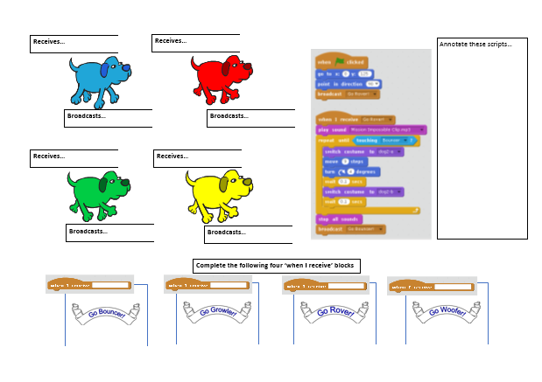
Activity 1: Analysing the provided broadcast example
Have a look at the third demo project in detail:
https://scratch.mit.edu/projects/138840667/
Check you can follow how each dog triggers the next dog to start running using broadcast messages.
Check you can follow how broadcast messages are also used to change the backdrop images
Explore how the dogs’ movement is animated using costume change and wait messages

Slide 11

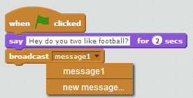


Activity 2: A short sprite conversation using broadcasting
1. Set up three sprites of your choice
4. Click on the second and third sprites and setup code similar to this.
2. In the first sprite set up something like this. Drag a broadcast block on the end and click on the small black triangle and select new.
5. Go back to the first sprite and continue the conversation like this
3. When the input box appears type 1 or a.
6. Continue the ‘conversation’ until all three sprites have made two contributions each
Based on http://code-it.co.uk/scratch/scratchconversation2

